Slide 1
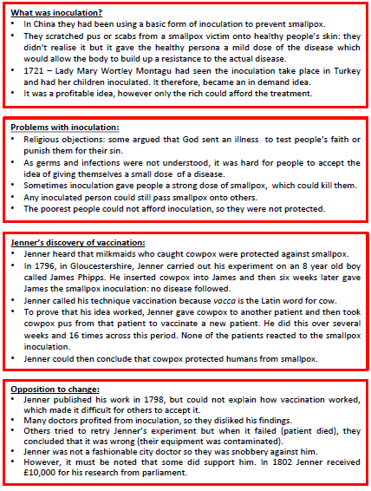
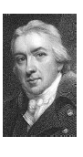
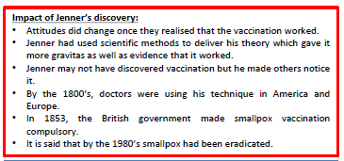
Health and the People Knowledge Organiser:
Edward Jenner and the discovery of vaccination
Key Term | Definition
Virus | An infection carried by molecules that are too small to be seen
Vaccination | Injection of a mild form of disease to stop you getting a more dangerous version of the disease
Inoculation | An early form of vaccination where the skin is scratched rather than injected

Slide 2
Tasks:
Read through the information
Define the keywords in your practise book
Answer the questions into your practise book
Answer the questions onto your question sheet (provided to you) from memory
Add any further information that you have missed in a different colour on the question sheet
Have another go at the questions from memory at a later time.
Checking your learning: You will undertake the quiz in your upcoming lesson. Ensure you have revised!
Edward Jenner and the discovery of the Smallpox Vaccination Quiz Questions
Define what Inoculation means
Define what Vaccination means
Identify two problems with Inoculation
What was Jenner’s theory regarding milkmaids?
How did Jenner prove his theory?
6. What was Jenner unable to explain about his new vaccination?
7. Why were Inoculators against this new vaccination?
8. Where were doctors using Jenner’s new vaccination in the 1800s?
9. In what year did the British government make the Smallpox vaccination compulsory?
10. What had happened by the 1980s?

Slide 3
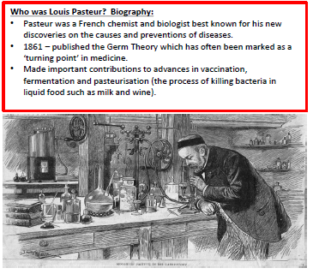
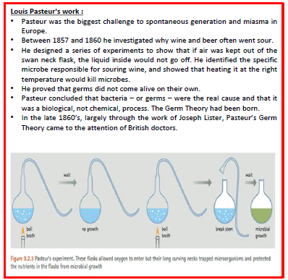
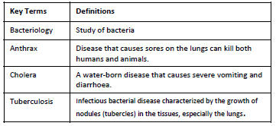
Health and the People Knowledge Organiser: Louis Pasteur and Robert Koch

Slide 4
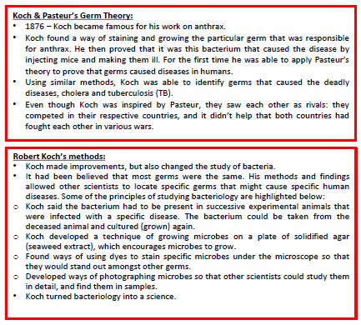
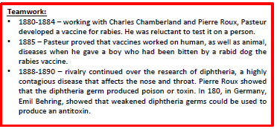
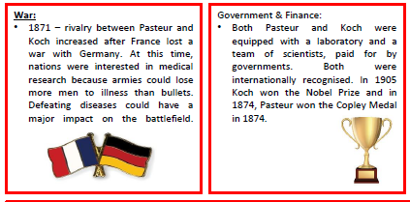
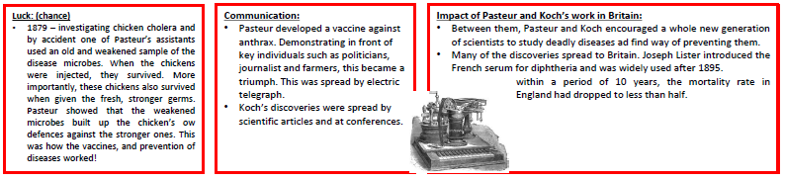

Slide 5
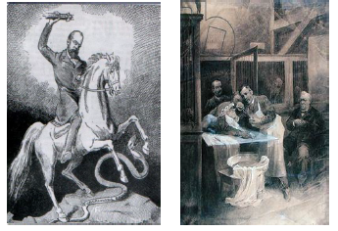
Tasks:
Read through the information
Define the keywords in your practise book
Answer the questions into your practise book
Answer the questions onto your question sheet (provided to you) from memory
Add any further information that you have missed in a different colour on the question sheet
Have another go at the questions from memory at a later time.
Checking your learning: You will undertake the quiz in your upcoming lesson. Ensure you have revised!
Louis Pasteur and Robert Koch Quiz Questions
In what year did Louis Pasteur publish his Germ Theory?
Name two beliefs people held on what caused disease in the 1800s before Pasteur’s Germ Theory.
How did Pasteur prove that germs were in the air?
What did Koch become famous for in 1876 with his work on Anthrax?
Name two diseases where Koch was able to identify the germs that caused them?
6. What did Koch’s work allow other scientists to do?
7. Name one technique Koch developed that allowed microbes to be identified.
8. What disease was Pasteur studying that helped him understand how vaccination worked?
9. Pasteur gave a boy what vaccine in 1885?
10. Identify two factors that helped Pasteur and Koch in their work and explain how these factors helped them.

Slide 6
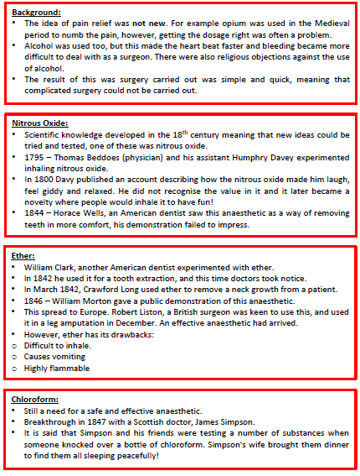
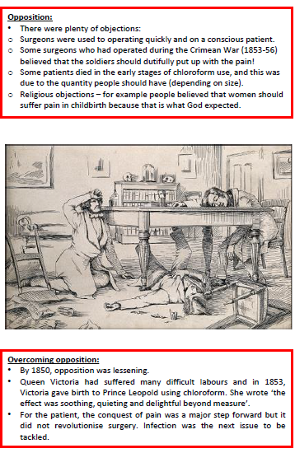
Key Term | Definition
Anaesthetic | A substance that stops a patient feeling pain
Health and the People Knowledge Organiser: Development of Anaesthetics in the 1800s

Slide 7
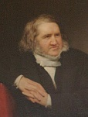
Tasks:
Read through the information
Define the keywords in your practise book
Answer the questions into your practise book
Answer the questions onto your question sheet (provided to you) from memory
Add any further information that you have missed in a different colour on the question sheet
Have another go at the questions from memory at a later time.
Checking your learning: You will undertake the quiz in your upcoming lesson. Ensure you have revised!
James Simpson
1811-1870
Key Discovery: Discovered and used Chloroform (1848)
Before: Ether was used but was generally unpopular.
After: Chloroform was used into the 20th century.
During: Chloroform was well used and much better as it did NOT cause the patients to cough.
Problems: Chloroform is very dangerous as 1/3 of a teaspoon will put you to sleep but 1/2 a teaspoon will kill you. Many young people died as they needed more to put them under. This was made safe by JOHN SNOW who used it on Queen Victoria
Development of Anaesthetics in the 1800s Quiz Questions
Define what the word Anaesthetic means.
What methods of anaesthetic were used before the 1800s?
What gas did Humphrey Davy use in 1800?
Which British surgeon used Ether in a leg amputation in 1846?
Identify two drawbacks to using Ether in surgery?
6. What did James Simpson discover in 1847?
7. Why were many people dying as a result of the use of Simpson’s discovery?
8. Identify three other reasons why there was opposition to this new discovery?
9. Which key person was important in overcoming this opposition?
10. Despite this discovery being a step forward, which other problem in surgery was the next issue to be tackled?

Slide 8
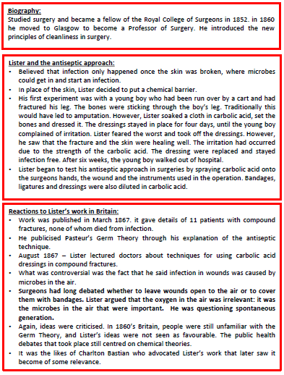
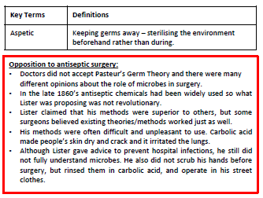
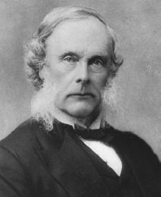
Health and the People Knowledge Organiser: Surgery by the end of the 1800s
Joseph Lister
1827-1912
Key Discovery: ANTISEPTIC Surgery, through Carbolic Spray.
Before: Doctors rarely washed hands or instruments. A bloody apron was the sign of a good doctor.
After: His ideas were mostly accepted but it took up to 20 years for them to be fully used nationwide. People started to adapt his ideas and called for the use of gloves and different gowns for surgery
During: He worked with his ideas and cut his death rates from 46% (1867) to 15% (1870). He later started to use Aseptic surgery and steam to sterilise his instruments.

Slide 9
Tasks:
Read through the information
Define the keywords in your practise book
Answer the questions into your practise book
Answer the questions onto your question sheet (provided to you) from memory
Add any further information that you have missed in a different colour on the question sheet
Have another go at the questions from memory at a later time.
Checking your learning: You will undertake the quiz in your upcoming lesson. Ensure you have revised!
Despite advances in anatomy Surgery still had three main problems: PAIN, INFECTION and BLOOD LOSS
Surgery has progressed and dealt with pain and infection. However BLOOD LOSS is still a problem
19th Century Surgery Timeline
1799 Humphrey Davy discovers Laughing Gas
1847 Ignaz Semmelweis makes the link between doctors not washing their hands and deaths in patients.
1847 Liston uses Ether in an operation.
1848 Simpson uses Chloroform in operations
1870s Lister is using Carbolic Spray in operations
Individuals pioneered new techniques in surgery increasing survival rates
Surgery by the end of the 1800s quiz questions
Person and Date | Invention/Change | Significance
Charles Chamberland, 1881 | Steam steriliser for medical instruments | Removed the need for carbolic acid and increased surgical survival rates
Gustav Neuber, 1886 | Aseptic Surgery: this is when all possible germs are removed from the operating theatre | Built on Lister’s ideas and aided by Koch’s discovery of the bacterium which caused septicaemia (blood poisoning). This gave proof of germs in the air causing deaths in surgery. Reduced mortality rates.
What were the three main problems of surgery at the start of the 1800s?
How was infection caused in surgery according to Lister?
What did Lister discover and use to prevent infection in surgery?
How did Lister test his idea/discovery?
Which theory did Lister support through his explanation of his antiseptics technique?
Explain two reasons why there was opposition to Lister’s antiseptic methods.
Lister reduced his death rates in surgery from 46% (1867) to what in 1870 by using antiseptics?
What did Charles Chamberland discover that helped surgery?
What was Aseptic surgery?
What problem still existed at the end of the 19th century in surgery?

Slide 10
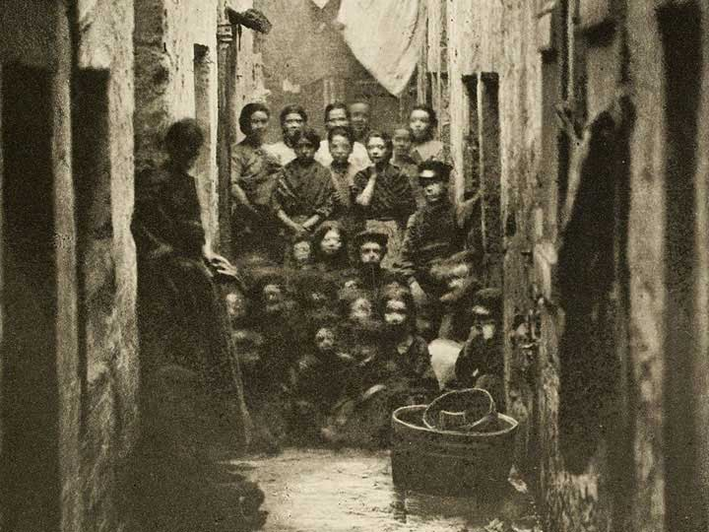
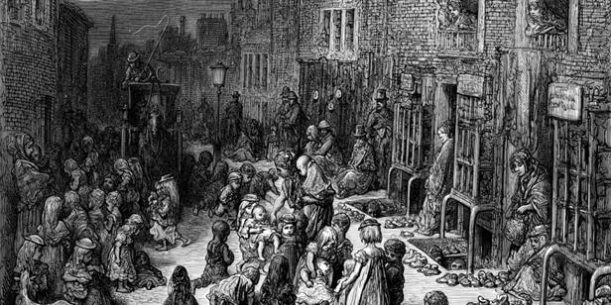
The government has paid little attention to Public Health. As the Industrial Revolution bought more people into the cities people’s health declined, due to overcrowding and poor sanitation
Health and the People Knowledge Organiser: Public Health in the 1800s
Public Health had begun to improve but people were still expected to live for themselves.
Public Health Timeline
1750-Beginning of the Industrial Revolution. People start to move into the cities for work. Sanitation and public health decline
1831- First Cholera epidemic.
1842- Chadwick publishes his Working conditions of the Working Poor which encourages the government to spend money on the poor to improve their health
1848 1st Public Health Act. Councils CAN set up Health Boards but they are NOT COMPULSORY
1854- John Snow connect Cholera with dirty water.
1858 – The Great Stink. The Thames dries up leaving the stinking mud to foul the city. Parliament decide to solve this problem by building sewers.
1866- Joseph Bazelgette finishes the sewers in London.
1875 – 2nd Public Health Act. Councils MUST set up Health Boards and improve sanitation
1889- Booth shows that 1/3 of the population of London were living below the poverty line
1899- shows that 1/3 of the population of York were living below the poverty line
In the Beginning
Many people lived in cramped conditions with little access to good sanitation. Back to Back housing was common and the government attitude was ‘Laissez-Faire’ (let it be) which meant they did nothing about it. It was believed that the poor were poor because they did not work hard enough.
Why did things begin to change?
Slowly people’s attitudes began to change.
People like Joseph Chamberlain who was the Mayor of Birmingham started to think that the poor needed help. He created a much cleaner city before the 1875 Public Health act came into force.
The fact that Working class men got the vote in 1867 also saw a big shift in the views of Laissez-Faire because the politicians now had to appeal to more of the people, not just the ratepayers (taxpayers).
Opposition to Public Health
People thought it would make the poor lazy as they wouldn’t have to work their way out of the slums.
They were worried about the cost
Very little of the poor conditions affected the ratepayers lives so they didn’t want to change anything
It was considered the poor’s own fault if they were poor.

Slide 11

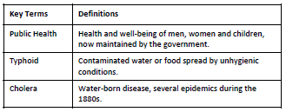
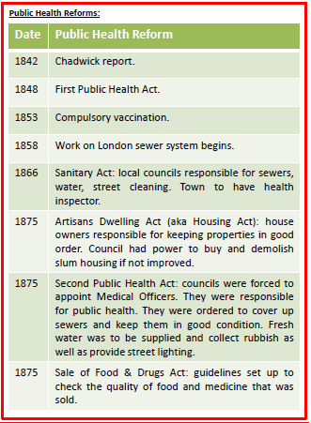
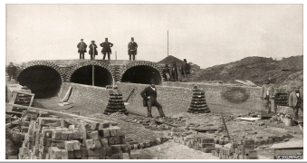
Tasks:
Read through the information
Define the keywords in your practise book
Answer the questions into your practise book
Answer the questions onto your question sheet (provided to you) from memory
Add any further information that you have missed in a different colour on the question sheet
Have another go at the questions from memory at a later time.
Checking your learning: You will undertake the quiz in your upcoming lesson. Ensure you have revised!
Public Health in the 1800s quiz questions
Describe what conditions were like for people in the beginning of the 1800s
What attitude did the government have at the start of the 1800s and explain what this means?
What is Cholera?
What did John Snow discover?
What did Edwin Chadwick try to encourage in his 1842 report?
6. Why did the first Public Health Act in 1848 fail?
7. What happened in 1867 and why was this important in improving public health?
8. What did the Second Public Health Act in 1875 state?
9. Why was there opposition to the Public Health reforms?
10. What problems still existed at the end of the 19th century that were highlighted by Booth and Rowntree?

